Slide 1
Data Analytics
Outliers

Slide 2
Agenda
Outlier and Outlier Analysis
Outlier Detection Methods
  Statistical Approaches
  Distance-Based Approaches
  Classification/Clustering-Based Approaches
Summary

Slide 3
What Are Outliers?
Outlier: A data object that deviates significantly from the normal objects as if it were generated by a different mechanism
  Ex.: Unusual credit card purchase, sports: Michael Jordon, Wayne Gretzky, ...
Outliers are different from the noise data
  Noise is random error or variance in a measured variable
  Noise should be removed before outlier detection
  We remove noise; we investigate outliers

Slide 4
What Are Outliers?
Outliers are interesting: It violates the mechanism that generates the normal data
Applications:
  Credit card fraud detection
  Telecom fraud detection
  Customer segmentation
  Medical analysis

Slide 5
Types of Outliers (I)
Three kinds: global, contextual and collective outliers
Global outlier (or point anomaly)
  Object is O_{g} if it significantly deviates from the rest of the data set
  Ex. Intrusion detection in computer networks (One login from an unusual country, one packet wildly unlike anything normal)
  Issue: Find an appropriate measurement of deviation
Global Outlier
5

Slide 6
Types of Outliers (II)
Contextual outlier (or conditional outlier)
  Object is O_{c} if it deviates significantly based on a selected context
  Ex. 85º F in Johnson City: outlier? (depending on summer or winter?)
  Attributes of data objects should be divided into two groups
    Contextual attributes: defines the context, e.g., time & location
    Behavioral attributes: characteristics of the object, used in outlier evaluation, e.g., temperature
  Can be viewed as a local outliers—whose density significantly deviates from its local area
  Issue: How to define or formulate meaningful context?
6

Slide 7
Types of Outliers (III)
Collective Outliers
  A subset of data objects collectively deviate significantly from the whole data set, even if the individual data objects may not be outliers
  Applications: E.g., intrusion detection:
    When a number of computers keep sending denial-of-service packages to each other
Collective Outlier
  Detection of collective outliers
    Consider not only behavior of individual objects, but also that of groups of objects
    Need to have the background knowledge on the relationship among data objects, such as a distance or similarity measure on objects.
7
Notes:
1. Global is one weird point
2. Contextual is one point weird for its situation
3. Collective is a weird group.

Slide 8
Challenges of Outlier Detection
Modeling normal objects and outliers properly
  Hard to enumerate all possible normal behaviors in an application
  The border between normal and outlier objects is often a gray area
Application-specific outlier detection
  Choice of distance measure among objects and the model of relationship among objects are often application-dependent
  E.g., clinic data: a small deviation could be an outlier; while in marketing analysis, larger fluctuations
Handling noise in outlier detection
  Noise may distort the normal objects and blur the distinction between normal objects and outliers. It may help hide outliers and reduce the effectiveness of outlier detection
Understandability
  Understand why these are outliers: Justification of the detection
  Specify the degree of an outlier: the unlikelihood of the object being generated by a normal mechanism
8

Slide 9
Outlier Detection I: Supervised Methods
Two ways to categorize outlier detection methods:
  Based on whether user-labeled examples of outliers can be obtained:
    Supervised, semi-supervised vs. unsupervised methods
  Based on assumptions about normal data and outliers:
    Statistical, proximity-based, and clustering-based methods
Outlier Detection I: Supervised Methods
  Modeling outlier detection as a classification problem
    Samples examined by domain experts used for training & testing
  Methods for Learning a classifier for outlier detection effectively:
    Model normal objects & report those not matching the model as outliers, or
    Model outliers and treat those not matching the model as normal
  Challenges
    Imbalanced classes, i.e., outliers are rare: Boost the outlier class and make up some artificial outliers
    Catch as many outliers as possible, i.e., recall is more important than accuracy (i.e., not mislabeling normal objects as outliers)
9

Slide 10
Outlier Detection II: Unsupervised Methods
Assume the normal objects are somewhat ``clustered'‘ into multiple groups, each having some distinct features; and outliers not belonging into any cluster
An outlier is expected to be far away from any groups of normal objects
Weakness: Cannot detect collective outlier effectively
  Normal objects may not share any strong patterns, but the collective outliers may share high similarity in a small area
Ex. In some intrusion or virus detection, normal activities are diverse
  Unsupervised methods may have a high false positive rate but still miss many real outliers.
10

Slide 11
Agenda
Outlier and Outlier Analysis
Outlier Detection Methods
  Statistical Approaches
  Distance-Based Approaches
  Classification/Clustering-Based Approaches
Summary
11
Notes:
11

Slide 12
Outlier Detection: Statistical Methods
Statistical methods (also known as model-based methods) assume that the normal data follow some statistical model
  The data not following the model are outliers.
Effectiveness of statistical methods: highly depends on whether the assumption of statistical model holds in the real data
Univariate vs Multivariate Data:
  Univariate data: A data set involving only one attribute or variable
  Multivariate data: A data set involving two or more attributes or variables. Multivariate outlier detection task can be transformed into a univariate outlier detection problem
Notes:
The problem is that a point can look perfectly normal on every single variable by itself, yet be strange in combination. Example: height and weight. A person who is 5 feet tall is not unusual, and a person who weighs 250 pounds is not unusual, but 5 feet and 250 pounds together is unusual. If you check height alone and weight alone (two separate univariate tests), you miss it. The outlier only shows up when you look at the variables together.
The standard way to compute that single score is a distance called the Mahalanobis distance.

Slide 13
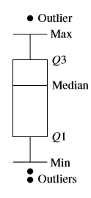
Statistical Methods: Detection using the interquartile range (IQR) – aka the boxplot method
plots the univariate input data using a ﬁve-number summary (see Figure)
The ﬁve-number summary:
  the smallest nonoutlier value (Min),
  the lower quartile (Q1),
  the median (Q2),
  the upper quartile (Q3), and
  The largest non outlier value (Max).
The interquartile range (IQR) is deﬁned as Q3−Q1.
Any object that is more than 1.5×IQR smaller than Q1 or 1.5×IQR larger than Q3 is treated as an outlier because the region between Q1−1.5×IQR and Q3+1.5×IQR contains 99.3% of the objects.
Objects outside that range are outliers shown by circles in the figure

Slide 14
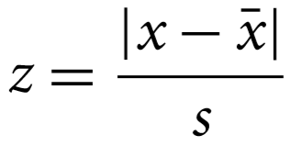
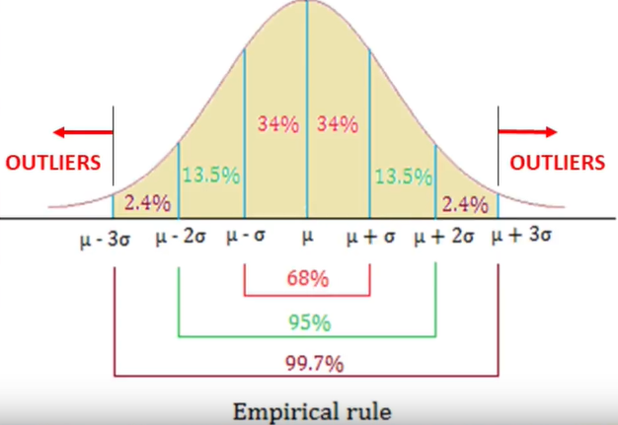
Statistical Methods: Standard Z (Z score)
Univariate outlier detection: The Grubb's test (maximum normed residual test) ─ another statistical method under normal distribution
  For each object x in a data set, compute its z-score:
  For each object x, it is considered an outlier if its z-score:
    Zscore(x) > 3 or Zscore(x) < -3
    Or
    Zscore(x) > 2.5 or Zscore(x) < -2.5
    Or
    Other thresholds (e.g., modified z score)

Slide 15
Statistical Methods: Detection Using Histogram
The model of normal data is learned from the input data.
Often makes fewer assumptions about the data, and thus can be applicable in more scenarios
Outlier detection using histogram:
  Figure shows the histogram of purchase amounts in transactions
  A transaction in the amount of $7,500 is an outlier, since only 0.2% transactions have an amount higher than $5,000
Problem: Hard to choose an appropriate bin size for histogram
  Too small bin size → normal objects in empty/rare bins, false positive
  Too big bin size → outliers in some frequent bins, false negative
15

Slide 16
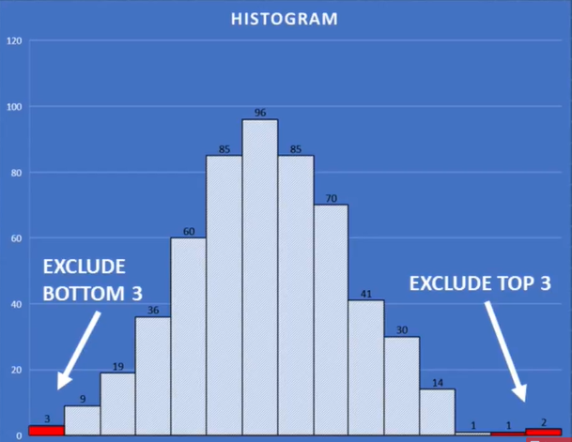
Example: Detection Using Histogram
  Remove x=3 top and x=3 bottom values from the data.
  Or
  Remove x=1.5% of the lowest count values. i.e., values the very low count (very short bar) will be removed

Slide 17
Agenda
Outlier and Outlier Analysis
Outlier Detection Methods
  Statistical Approaches
  Distance-Based Approaches
  Classification/Clustering-Based Approaches
Summary

Slide 18
Outlier Detection: Distance-Based Methods
An object is an outlier if the nearest neighbors of the object are far away, i.e., the proximity of the object significantly deviates from the proximity of most of the other objects in the same data set
Example (right figure): Model the proximity of an object using its 3 nearest neighbors
  Objects in region R are substantially different from other objects in the data set.
  Thus the objects in R are outliers
The effectiveness of Distance-based methods highly relies on the distance measure.
In some applications, proximity or distance measures cannot be obtained easily.
Often have a difficulty in finding a group of outliers which stay close to each other
18

Slide 19
Distance-Based Outlier Detection
Intuition: Objects that are far away from the others are outliers based on a distance measure.
Assumption of proximity-based approach: The proximity of an outlier deviates significantly from that of most of the others in the data set
Distance-based outlier detection: An object o is an outlier if its neighborhood does not have enough other points
19

Slide 20
Gower Distance : Distance measure for Attributes of Mixed Type
A database may contain all attribute types
  Nominal, symmetric binary, asymmetric binary, numeric, ordinal
One may use a weighted formula to combine their effects
Gower Distance for attributes of mixed types

Slide 21

Gower Distance
A weighted formula to combine all attribute types
  Nominal, symmetric binary, asymmetric binary, numeric, ordinal
  f is binary or nominal:
    d_{ij}^{(f)} = 0 if x_{if} = x_{jf} , or d_{ij}^{(f)} = 1 otherwise
  f is ordinal
    Compute ranks r_{if} and
    Treat z_{if} as interval-scaled
  f is numeric: use the normalized distance

Slide 22
Agenda
Outlier and Outlier Analysis
Outlier Detection Methods
  Statistical Approaches
  Distance-Based Approaches
  Classification/Clustering-Based Approaches
Summary

Slide 23
Classification-Based Method : One-Class Model
Idea: Train a classification model that can distinguish “normal” data from outliers
A brute-force approach: Consider a training set that contains samples labeled as “normal” and as “outlier”
  But, the training set is typically heavily biased: # of “normal” samples likely far exceeds # of outlier samples
  Cannot detect unseen anomaly
One-class model: A classifier is built to describe only the normal class.
  Learn the decision boundary of the normal class using classification methods such as SVM
  Any samples that do not belong to the normal class (not within the decision boundary) are declared as outliers
  Adv: can detect new outliers that may not appear close to any outlier objects in the training set
23

Slide 24
Clustering-Based Outlier Detection
An object is an outlier if (1) it does not belong to any cluster, or (2) it belongs to a small or sparse cluster
Needs judgement
Small cluster?
24

Slide 25
Clustering-Based Outlier Detection:
Detecting Outliers in Small Clusters
FindCBLOF: Detect outliers in small clusters
  Find clusters, and sort them in decreasing size
  To each data point, assign a cluster-based local outlier factor (CBLOF):
  If obj p belongs to a large cluster, CBLOF = cluster_size X similarity between p and cluster
  If p belongs to a small one, CBLOF = cluster size X similarity between p and the closest large cluster
Ex. In the figure, o is outlier since its closest large cluster is C₁, but the similarity between o and C₁ is small. For any point in C₃ (all of them are outliers too), its closest large cluster is C₂ but its similarity from C₂ is low, plus |C₃| = 3 is small
25

Slide 26
Agenda
Outlier and Outlier Analysis
Outlier Detection Methods
  Statistical Approaches
  Distance-Based Approaches
  Classification/Clustering-Based Approaches
Summary

Slide 27
Data (already sorted): 20, 22, 23, 25, 26, 28, 30, 31, 33, 35, 120
Part A, the IQR rule:
Median (Q2)?
Q1 (median of the lower five) and Q3 (median of the upper five)? → Q1 = 23, Q3 = 33
IQR = Q3 − Q1?
Fences: Q1 − 1.5×IQR and Q3 + 1.5×IQR?
Which charges fall outside the fences?

Slide 28
Median (Q2)? → 28
Q1 (median of the lower five) and Q3 (median of the upper five)? → Q1 = 23, Q3 = 33
IQR = Q3 − Q1? → 10
Fences: Q1 − 1.5×IQR and Q3 + 1.5×IQR? → 8 and 48
Which charges fall outside the fences?
Only 120

Slide 29
Part B, the z-score: For this data the mean is 35.7 and the standard deviation is 27.0. Compute the z-score of the $120 charge. Is it an outlier by the |z| > 3 rule?
→ z = (120 − 35.7) / 27.0 = 3.1, just over 3.

Slide 30
Part B, the z-score: For this data the mean is 35.7 and the standard deviation is 27.0. Compute the z-score of the $120 charge. Is it an outlier by the |z| > 3 rule?
→ z = (120 − 35.7) / 27.0 = 3.1, just over 3.

Slide 31
Part C, discuss:
Is $120 definitely fraud?

Slide 32
No. It is flagged as unusual, but it could be a legitimate larger purchase. The method raises the flag; a human decides. That is the judgment point.
Because the $120 itself pulled the mean up to 35.7 and inflated the standard deviation to 27. Without it, the mean is about 27 and the standard deviation about 4.7, which would make its z-score nearly 20. This is the weakness I flagged: the z-score is contaminated by the very outlier it is trying to catch.
That is why analysts often trust the boxplot more.

Slide 33
Summary
Types of outliers
  global, contextual & collective outliers
Outlier detection
  Supervised or unsupervised
Statistical approaches (boxplots, z score, histograms)
Distance-base approaches
Classification approaches
Clustering-base approaches
33

